Slide 1
LIFE/work balance
We have started a #LIFEworkbalance campaign and we need your help to complete our LIFE/work balance survey.
We hope to publish the results soon, so please give 15 minutes of your time to help us get a true picture of school life.
Want to be a part of this campaign? Take the survey on our website and share it with your colleagues!
© Classroom Secrets Limited 2020

Slide 2
Year 5 – Spring Block 2 – Fractions – Equivalent Fractions
About This Resource:
This PowerPoint has been designed to support your teaching of this small step. It includes a starter activity and an example of each question from the Varied Fluency and Reasoning and Problem Solving resources also provided in this pack. You can choose to work through all examples provided or a selection of them depending on the needs of your class.
National Curriculum Objectives:
Mathematics Year 5: (5F2b) Identify, name and write equivalent fractions of a given fraction, represented visually, including tenths and hundredths
More Year 5 Fraction resources
Did you like this resource? Don’t forget to review it on our website.
© Classroom Secrets Limited 2019

Slide 3
Year 5 – Spring Block 2 – Fractions
Step 1: Equivalent Fractions
© Classroom Secrets Limited 2019

Slide 4
Introduction
Which images show ?
2
9
© Classroom Secrets Limited 2019

Slide 5
Introduction
Which images show ?
is 2 of 9 equal parts.
2
9
2
9
© Classroom Secrets Limited 2019

Slide 6
Varied Fluency 1
Colour of each shape.
2
6
© Classroom Secrets Limited 2019

Slide 7
Varied Fluency 1
Colour of each shape.
2
6
2 | = | 4
6 |  | 12
© Classroom Secrets Limited 2019

Slide 8
Varied Fluency 2
Colour the second image to show an equivalent fraction.
Write the fractions underneath.
=
=
© Classroom Secrets Limited 2019

Slide 9
Varied Fluency 2
Colour the second image to show an equivalent fraction.
Write the fractions underneath.
=
1
3
5
15
=
© Classroom Secrets Limited 2019

Slide 10
Varied Fluency 3
Fill in the missing divisor.
÷ ?
2 | = | 6
6 |  | 18
÷ ?
© Classroom Secrets Limited 2019

Slide 11
Varied Fluency 3
Fill in the missing divisor.
÷ 3
2 | = | 6
6 |  | 18
÷ 3
© Classroom Secrets Limited 2019

Slide 12
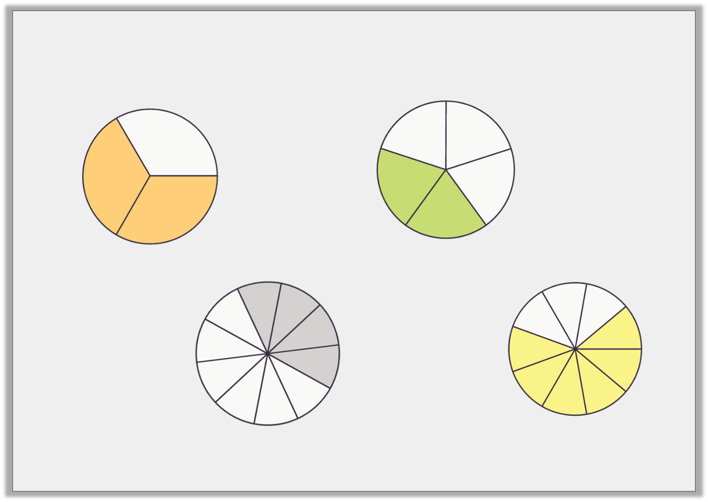
Varied Fluency 4
Match the equivalent fractions.
A.
B.
C.
D.
© Classroom Secrets Limited 2019

Slide 13
Varied Fluency 4
Match the equivalent fractions.
A and D match; B and C match.
A.
B.
C.
D.
© Classroom Secrets Limited 2019

Slide 14
Reasoning 1
Leida has coloured two grids to create an equivalent fraction.
Is Leida correct? Explain your answer.
=
I doubled the denominator and halved the numerator.
© Classroom Secrets Limited 2019

Slide 15
Reasoning 1
Leida has coloured two grids to create an equivalent fraction.
Is Leida correct? Explain your answer.
Leida is incorrect because…
=
I doubled the denominator and halved the numerator.
© Classroom Secrets Limited 2019

Slide 16
Reasoning 1
Leida has coloured two grids to create an equivalent fraction.
Is Leida correct? Explain your answer.
Leida is incorrect because if you double the denominator you
should do the same to the numerator.
=
I doubled the denominator and halved the numerator.
2 | = | 4
8 |  | 16
© Classroom Secrets Limited 2019

Slide 17
Reasoning 2
Chaz has drawn some equivalent fractions.
=
=
Find and correct any mistakes.
A
B
© Classroom Secrets Limited 2019

Slide 18
Reasoning 2
Chaz has drawn some equivalent fractions.
=
=
Find and correct any mistakes.
A should have…
B should have…
A
B
© Classroom Secrets Limited 2019

Slide 19
Reasoning 2
Chaz has drawn some equivalent fractions.
=
=
Find and correct any mistakes.
A should have 3 more parts shaded in because .
B should have 2 parts crossed out because .
A
B
2 | = | 6
5 |  | 15
3 | = | 6
7 |  | 14
© Classroom Secrets Limited 2019

Slide 20
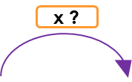
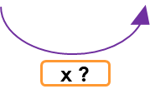
Problem Solving 1
Give 2 possible values for A and B.
2 | = | B
A |  | 12
© Classroom Secrets Limited 2019

Slide 21
Problem Solving 1
Give 2 possible values for A and B.
Various answers, for example:
or or
2 | = | B
A |  | 12
2 | = | 8
3 |  | 12
2 | = | 6
4 |  | 12
2 | = | 4
6 |  | 12
© Classroom Secrets Limited 2019

